Slide 1

Anna milanova
60m, 100m, 200m Sprinter

Slide 2
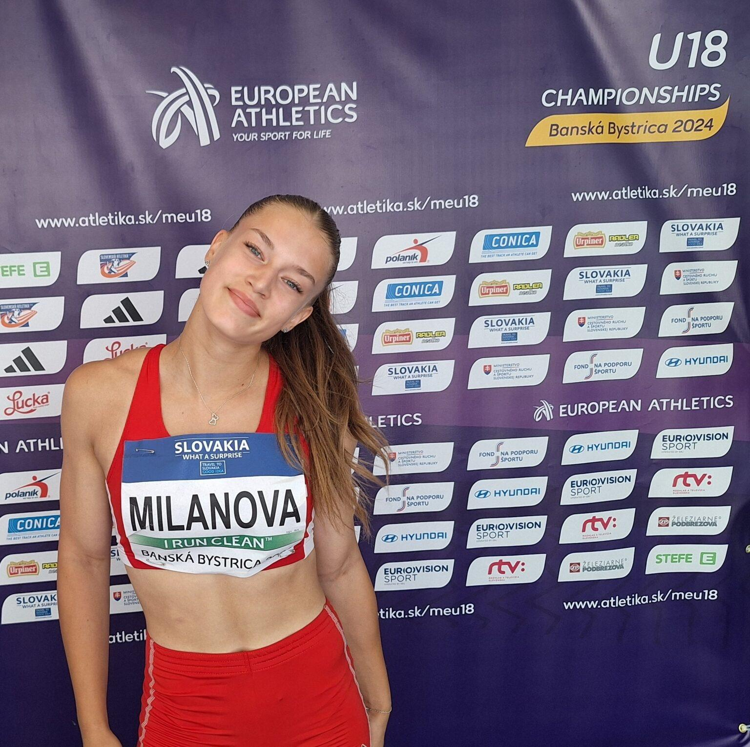

Slide 3
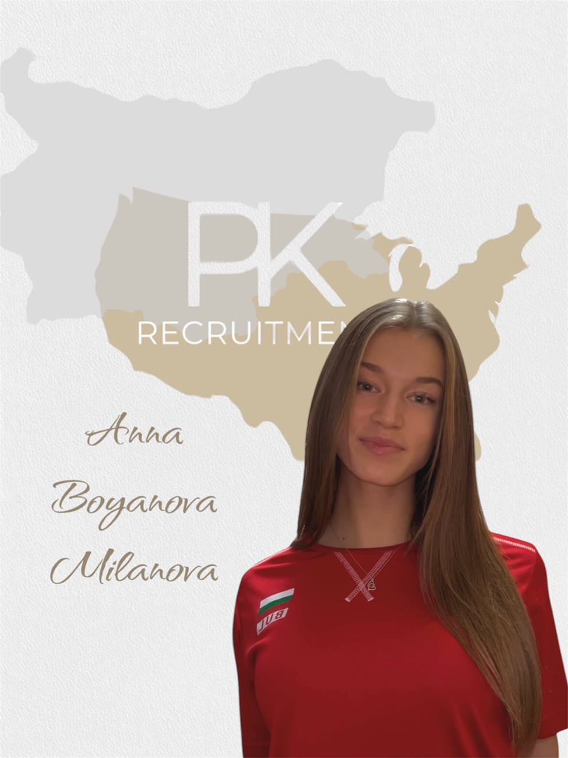
Gender: Female
Disciplines: 60m, 100m, 200m
Date of Birth: 16.07.2007
Graduation date: June, 2026
Club team: Ivet Lalova Sprint Academy

Slide 4
Videos:
  Balkan championship u18 -06.07.2024
  https://www.youtube.com/watch?v=owBNYq00070
  National Champion U18
  https://www.youtube.com/shorts/XO010diQR24
  Official profile in World Athletics:
  https://worldathletics.org/athletes/bulgaria/anna-milanova-14969264

Slide 5
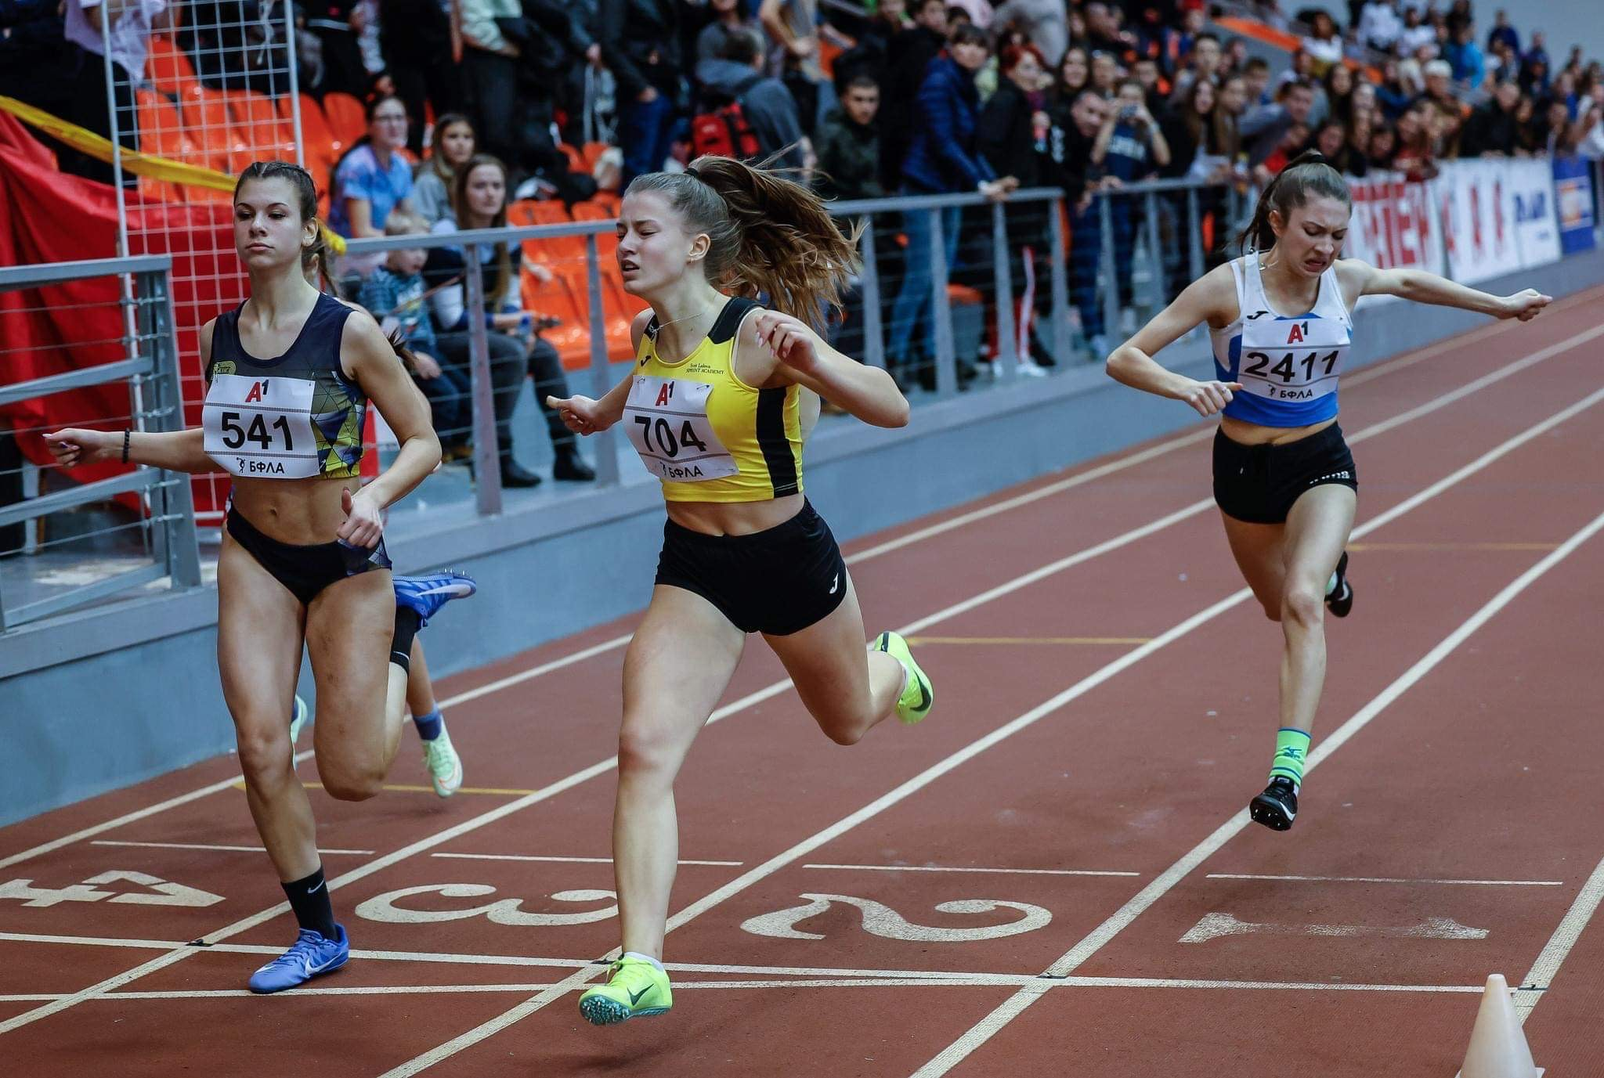

Slide 6
Additional information
Height: 162 cm.
Weight: 55 kg.
Athletic achievements: 81 medals
High school: Second English Language School “Thomas Jefferson”
Languages: Bulgarian, English, Spanish
Desired degree: TBA
SAT grade/date: TBA
TOEFL grade/date: TBA

Slide 7
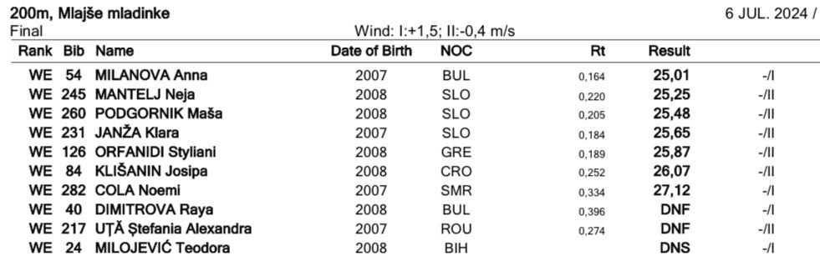

Slide 8
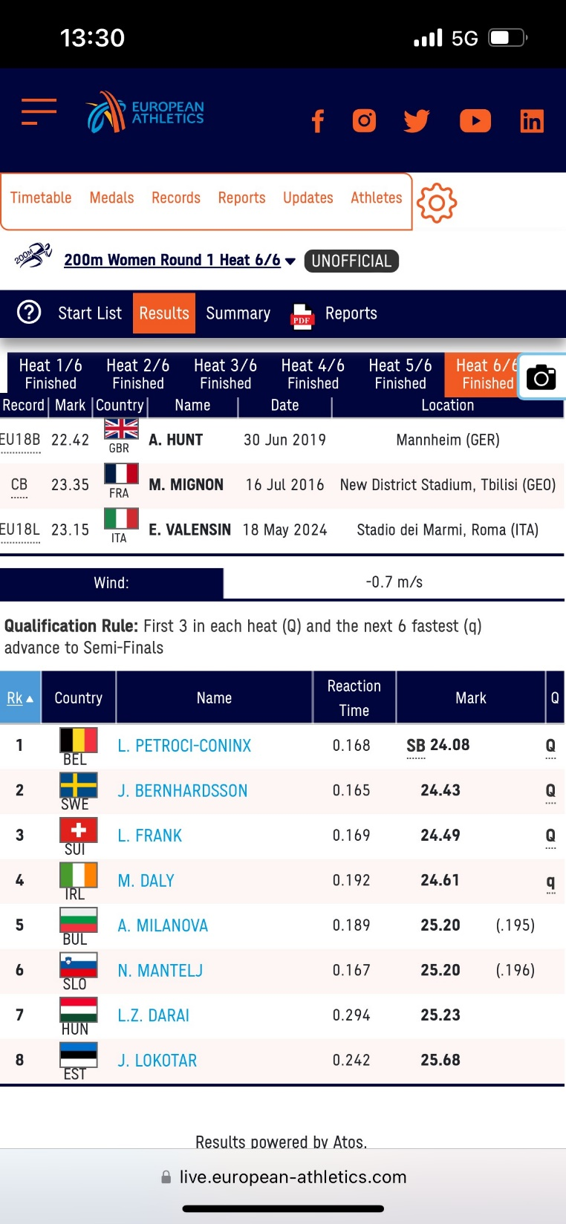
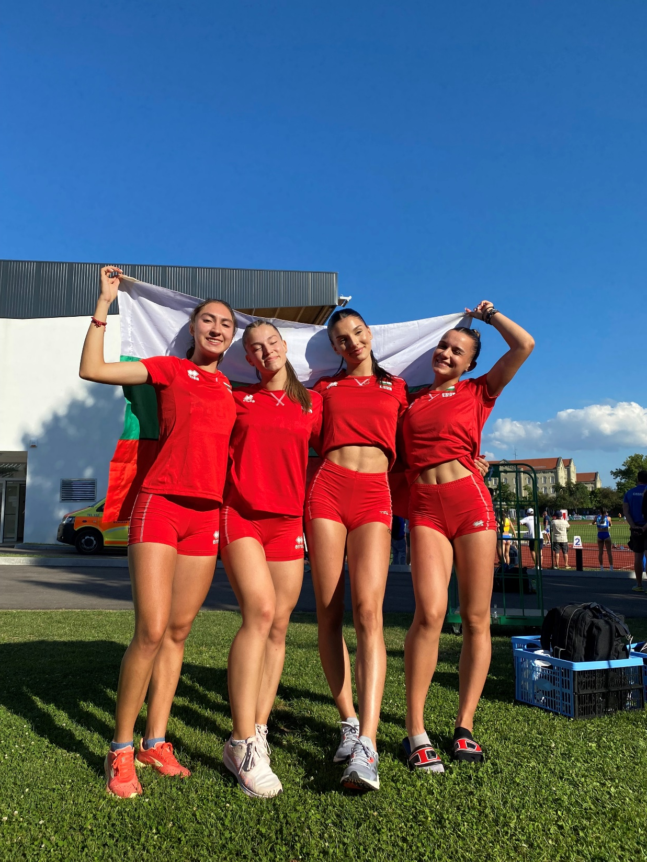

Slide 9
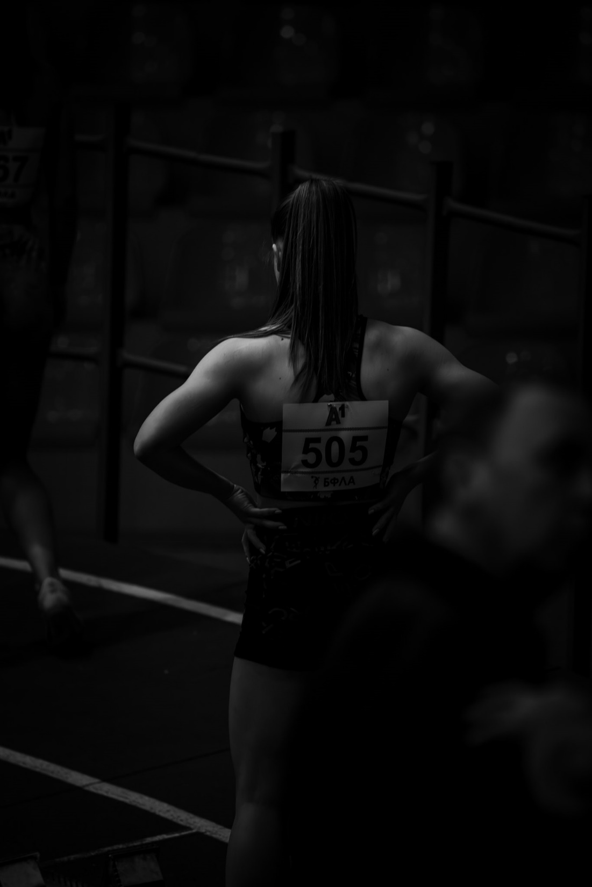
200m:
U20
2024: 3rd place- 25,29 (outdoor)
3rd place- 25,81(indoor)
2023: 2nd place- 25,89 (indoor)
U18
2024: 1st place- 25,66 (indoor)
3rd place- 25,36 (outdoor)
2023: 1st place- 26,10 (indoor)
2022: 1st place- 26,01(indoor)
3rd place - 26,42 (outdoor)
U16
2022: 1st place- 25,28 (indoor)
2nd place- 25,75 (outdoor)
2021: 2nd place-26,28 (outdoor)
2nd place -26,46 (indoor)

Slide 10
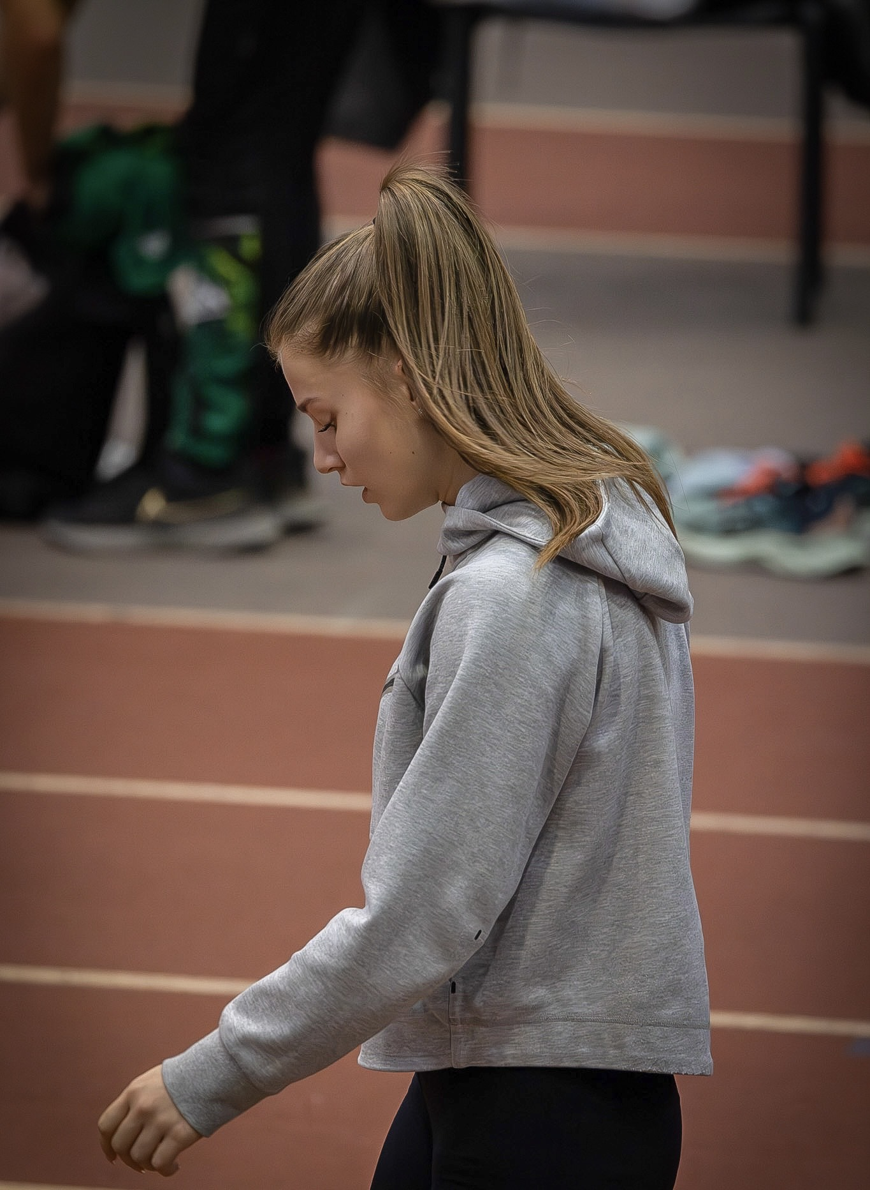
60m - indoor
U20
2023: 3rd place- 7,79
U18
2024:2nd place- 7,84
2023: 2nd place- 7,84
U16
2022:3rd place- 7,83
2021: 3rd place- 8,01

Slide 11
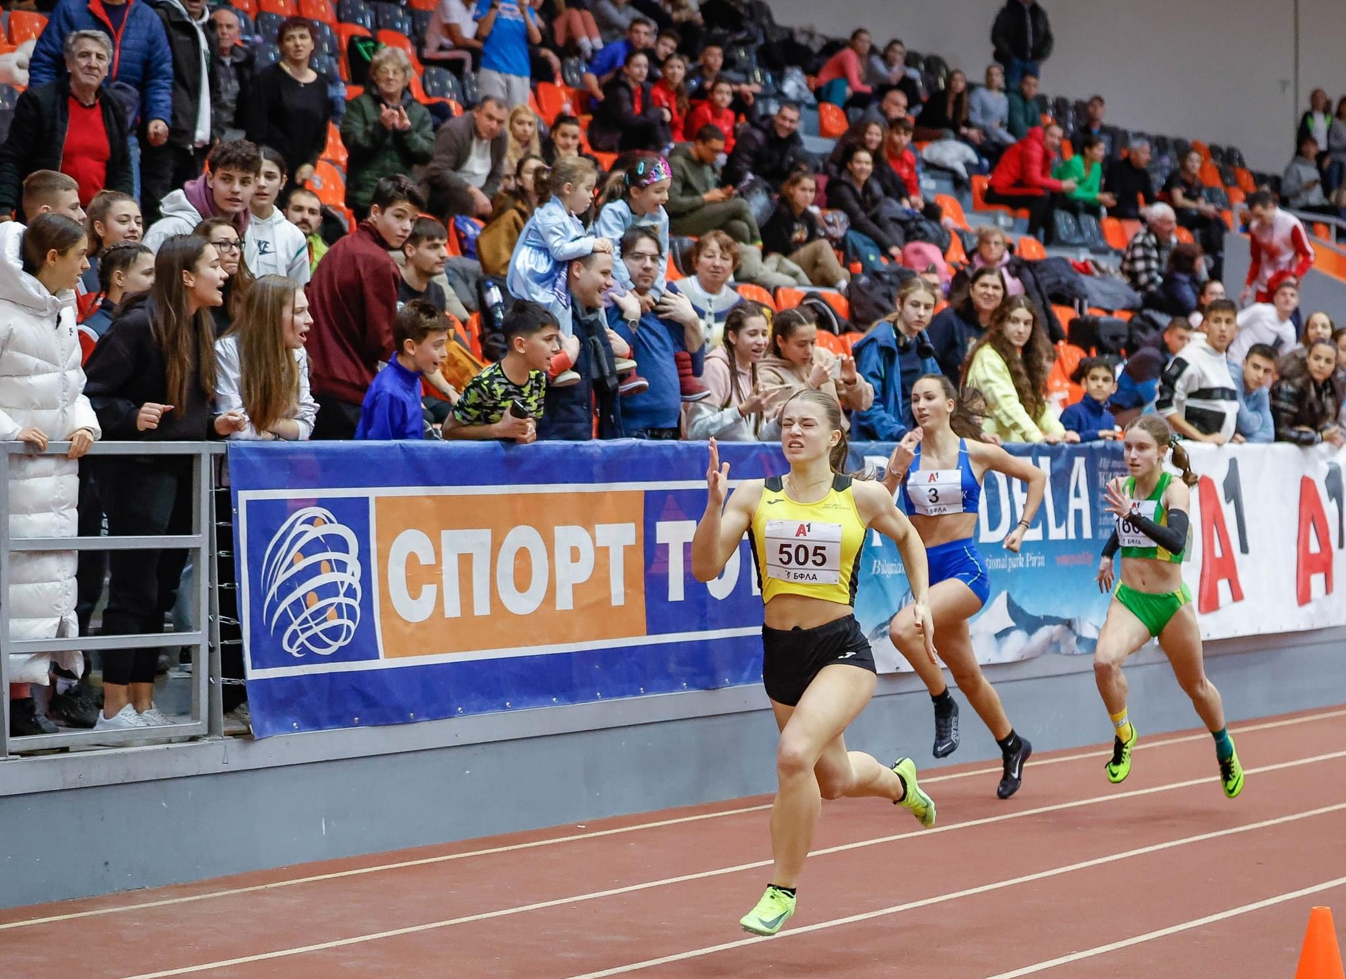

Slide 12
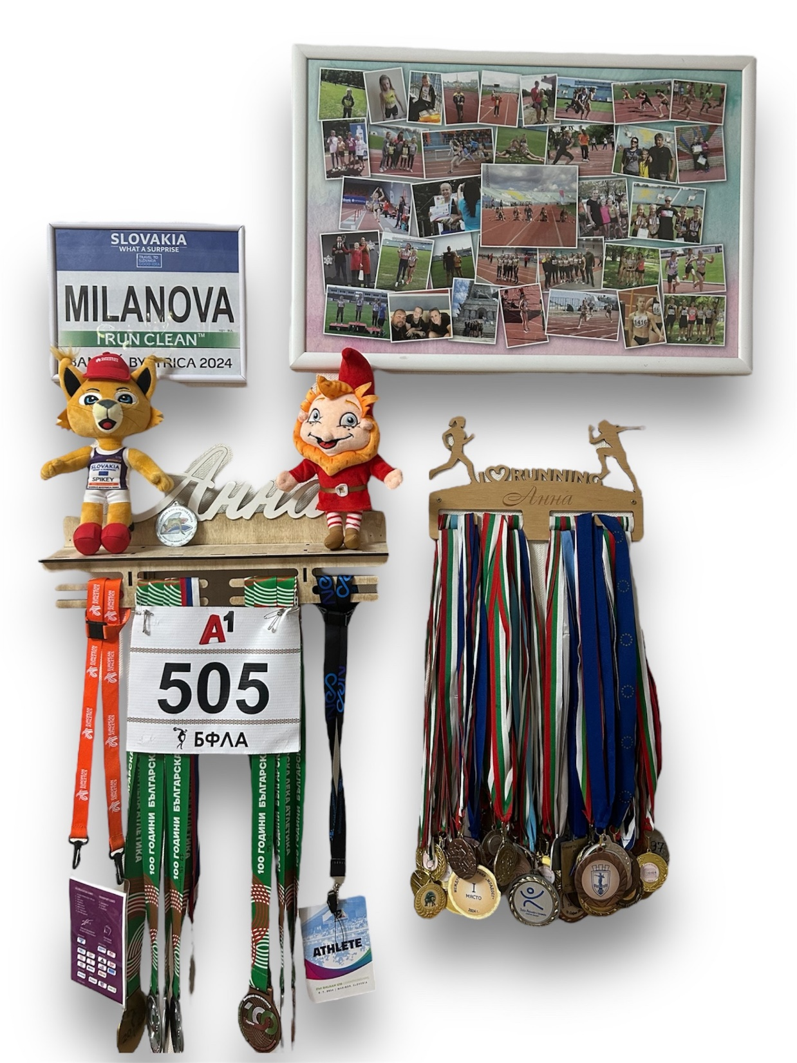
100m- outdoor
U18
2024: 2nd place- 12,15
U16
2022: 2nd place- 12,49
2021: 2nd place- 12,76

Slide 13
- Four-time national champion in the 200m for u20, u18 & u16
- Multiple medalist in the 60m and 100m, 200m- u20, u18, u16.
- 6th in the Bulgarian 200m rankings for 2024.
- Covered standard and participated in the European Championship and in the Balkan Championship u18-2024.
- Best result of the Balkan Championship in the 200m -25.01 (personal best)
- National record- 4x100 relay with the national team-47,11
Personal best: 100m- 12,15/ 60m- 7,79

Slide 14
Academic achievements:
- Excellent term and annual grades in all years of high school. (6,00)
- Part of the high school Parliament and participate in organizational and charity activities.
- Completed IT course “Computer Literacy” by a project of the Ministry of Education and passed a certificate.
- Participation in the National olympiad in Bulgarian language and literature and passing to the next competition round-municipal round.

Slide 15
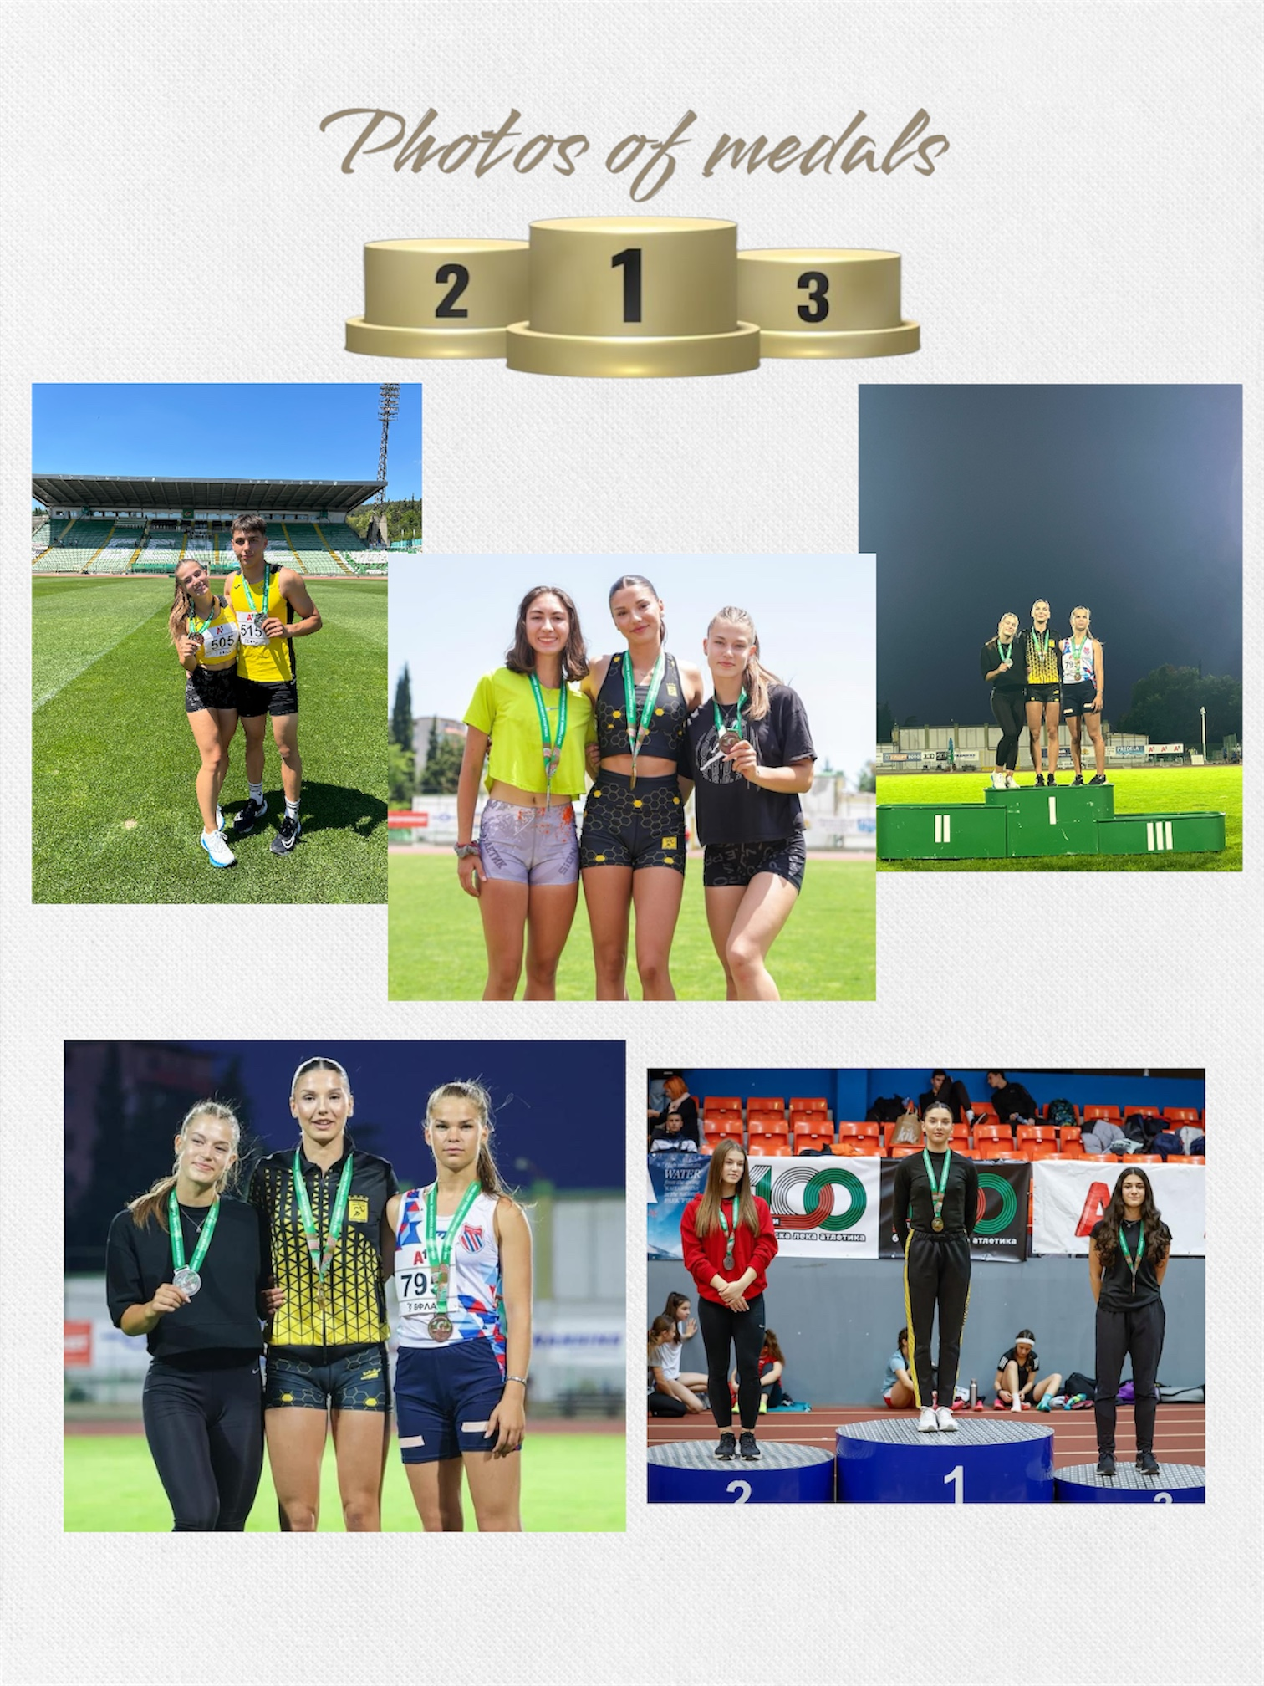
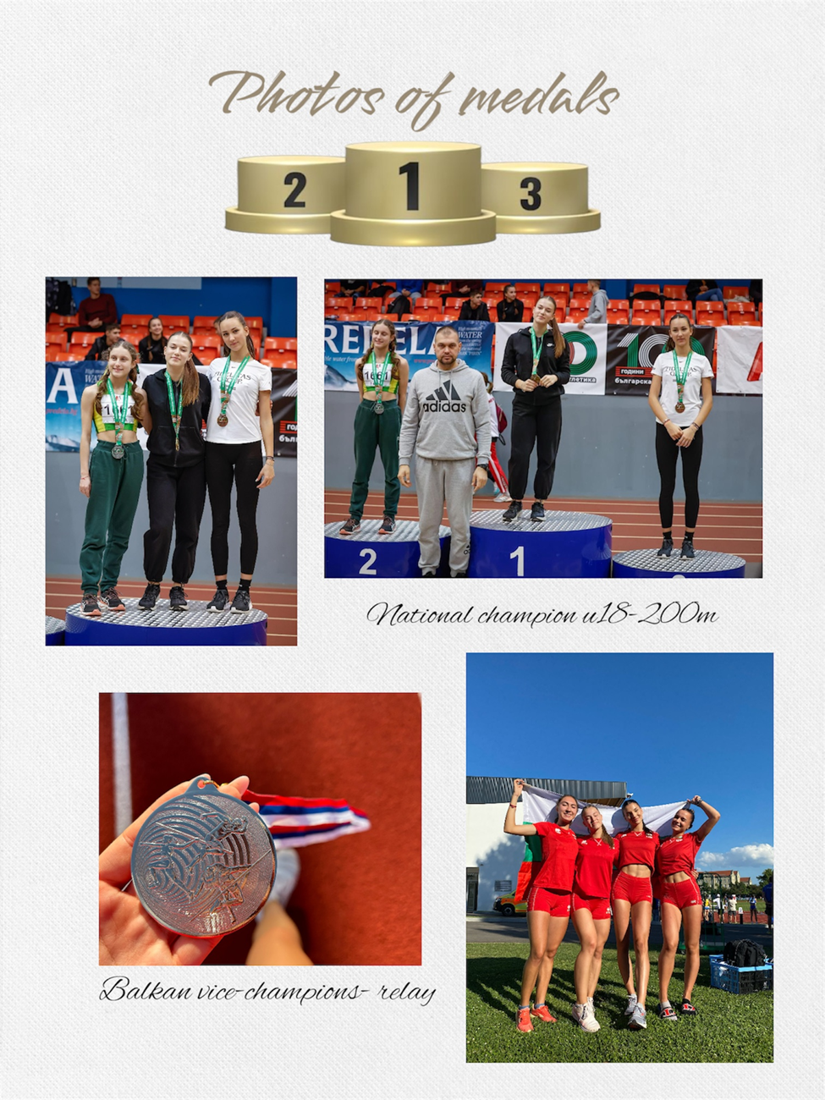

Slide 16
Interview questions
What does athletics mean to you?
For me track and field is and has always been much more than physical activity. On a personal level, playing sports helps me stay healthy and reduces stress. Track and field is the mean that built my character, taught me discipline, perseverance and will. Practices require consistent effort, focus and determination. It teaches me to overcome challenges, improve my skills and never give up, even when faced with setbacks. These lessons often translate beyond the track, shaping the way I approach other aspects of life. However, even though I have chosen to take up an individual sport, athletics has shown me support, loyalty, and friendship, which I receive from my coaches and teammates. Track and field teaches me that to succeed, you have to be dedicated and work hard, so I can say that this sport for me is proof that anything is possible.

Slide 17
Describe yourself with a few sentences:
Ambitious is how I would describe myself and the passion for athletics and the commitment to personal growth are very intrinsic to my personality. I love exploring new experiences and stepping out of my comfort zone by meeting interesting people and embracing unfamiliar environments. Being sociable comes naturally to me, so making friends has always been easy. To me, success means taking on challenges and working towards reaching my full potential. I have the determination and am ready to put in the effort to achieve my goals.

Slide 18
What does your education mean to you?
For me, education is a very important part of my development. It helps me look at life from a different perspective and empowers me with the general culture. It also allows me to make informed decisions, to feel competent to freely express my opinion and positions. I believe that education is the path to a stable future for me, working in a field that I have a passion for.

Slide 19
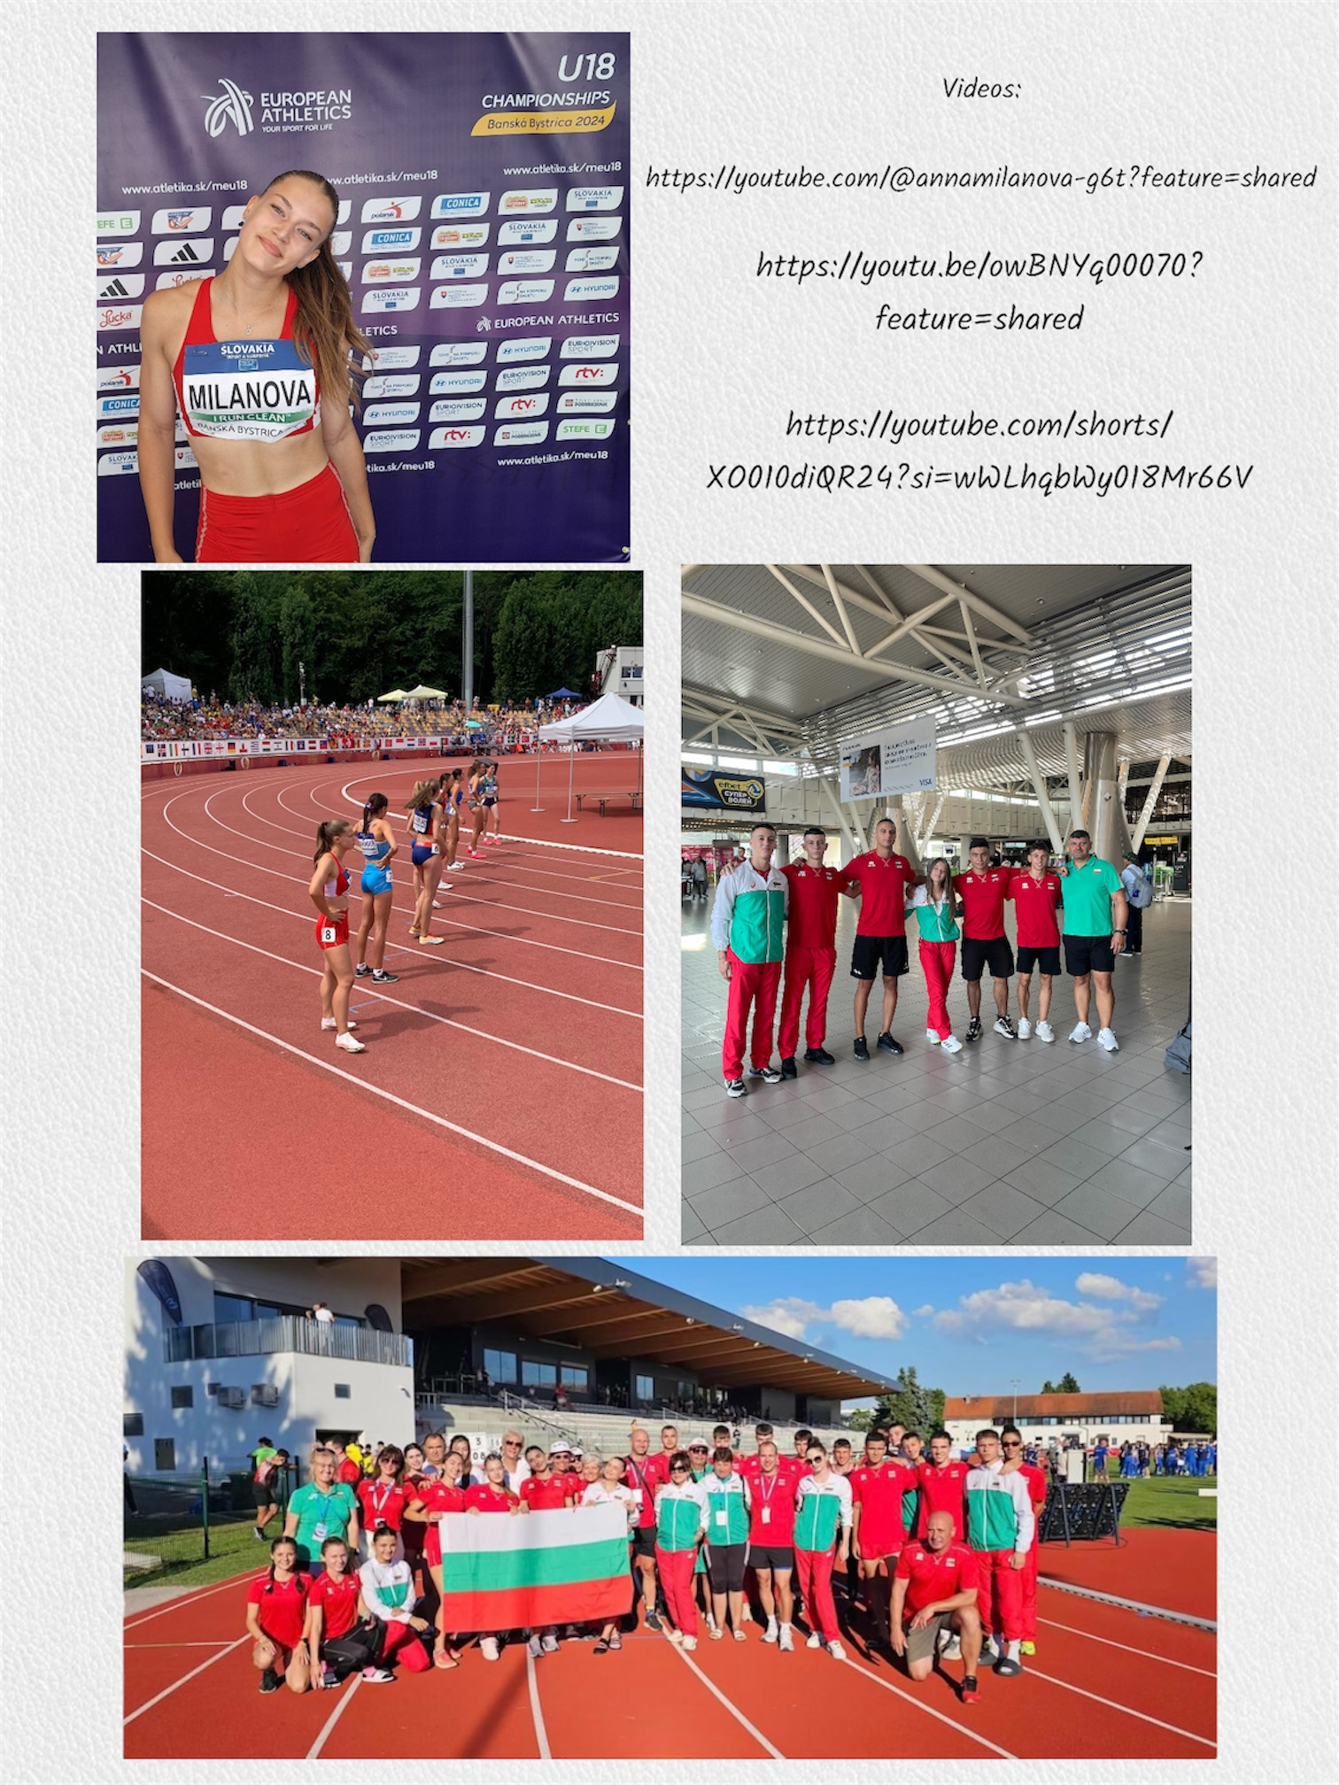

Slide 20
What are your main goals as a student-athlete in the USA?
As a student-athlete in the USA, my goals combine academic, athletic, and personal development objectives. My goal is to successfully balance my academic excellence and athletic performance. Taking advantage of the good conditions, I intend to have development in my athletic performance and participation in major competitions as a result of diligent training. Achieving high grades and mastering my field of study are equally important to me. I envisage adapting through effective time management and remaining focused on maintaining my physical and mental well-being to perform at my best. Ultimately, I strive to leave a meaningful legacy through my achievements and character, paving the way for success in all aspects of life.

Slide 21
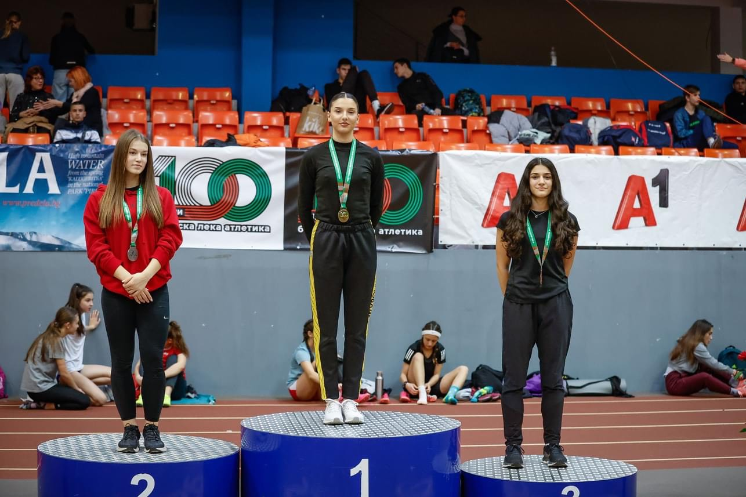

Slide 22


The presentation provides all the basic information for the student-athlete. More details and video can be provided if needed. Contact us.

